Slide 1
Angular Final Project Arun Krishna N an72@dedalus.eu

Slide 2
Features implemented
Following features have been implemented in this app development. JSON-Server-Auth nginx pipes Form handling Lazy loading of modules Routing, Child routing and params HTTPClient and Observables Angular Material Controls Service calls with secure end points (Token based auth)

Slide 3
Still in pending stage Register, Logout pending
User : 1. Once logged in using user type you will be routed to Hospital homepage.
2.On clicking Book now you will be redirected to appointment form submission.
3.On submitting, data will be updated to the JSON Server
Admin:
1.You will access the “Pending status ” appointments as shown below
2.On clicking the approve It will be updated in the JSON.

Slide 4
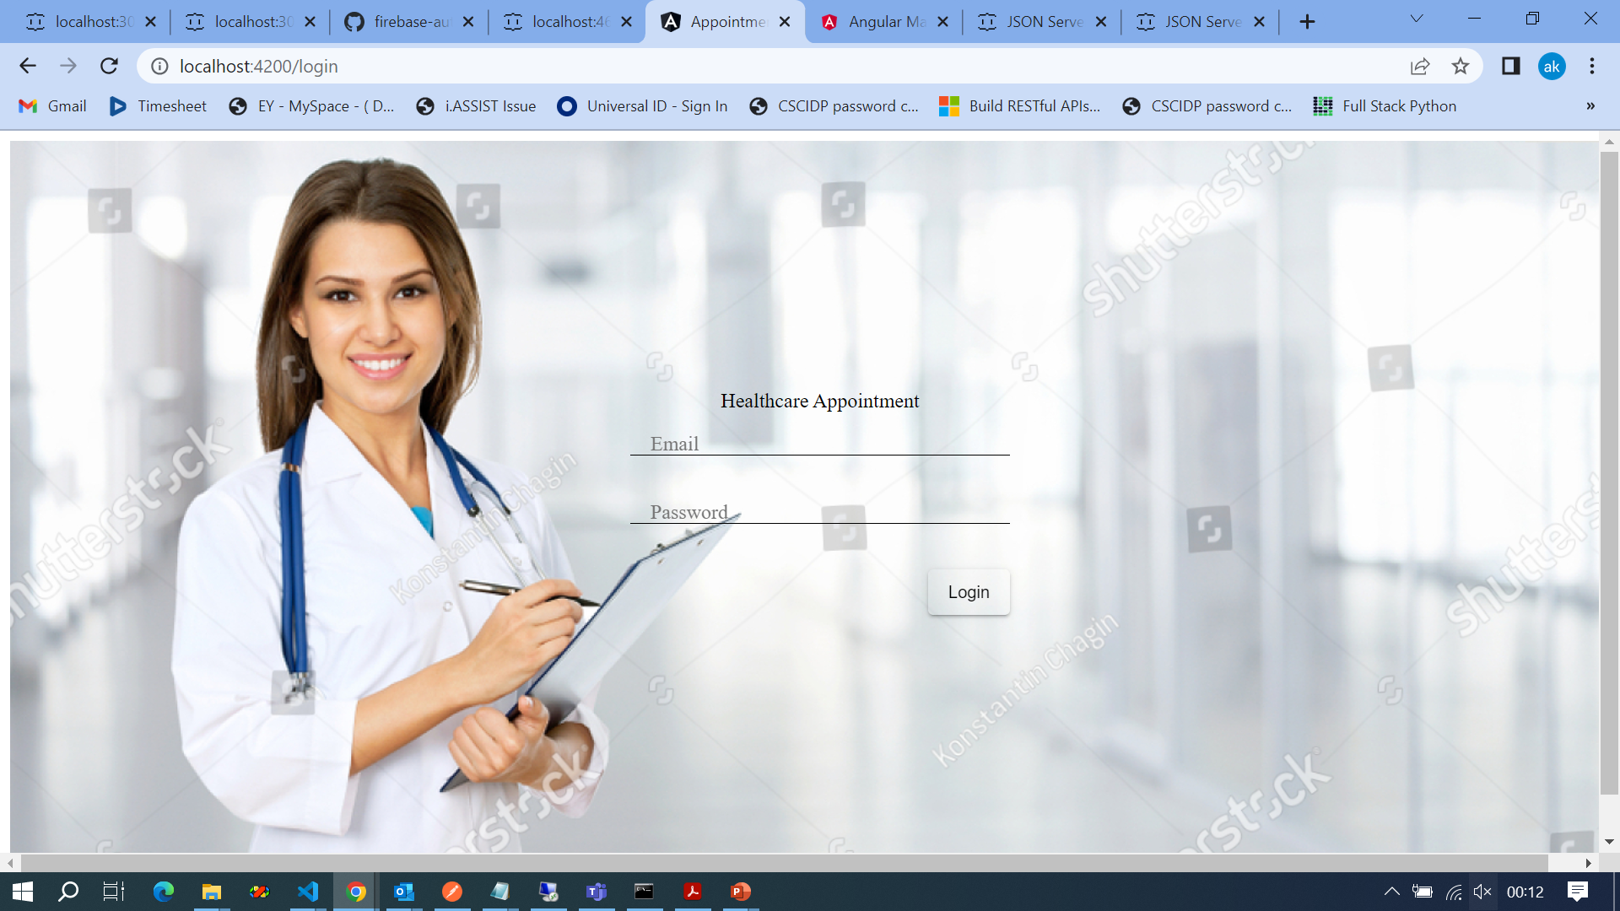
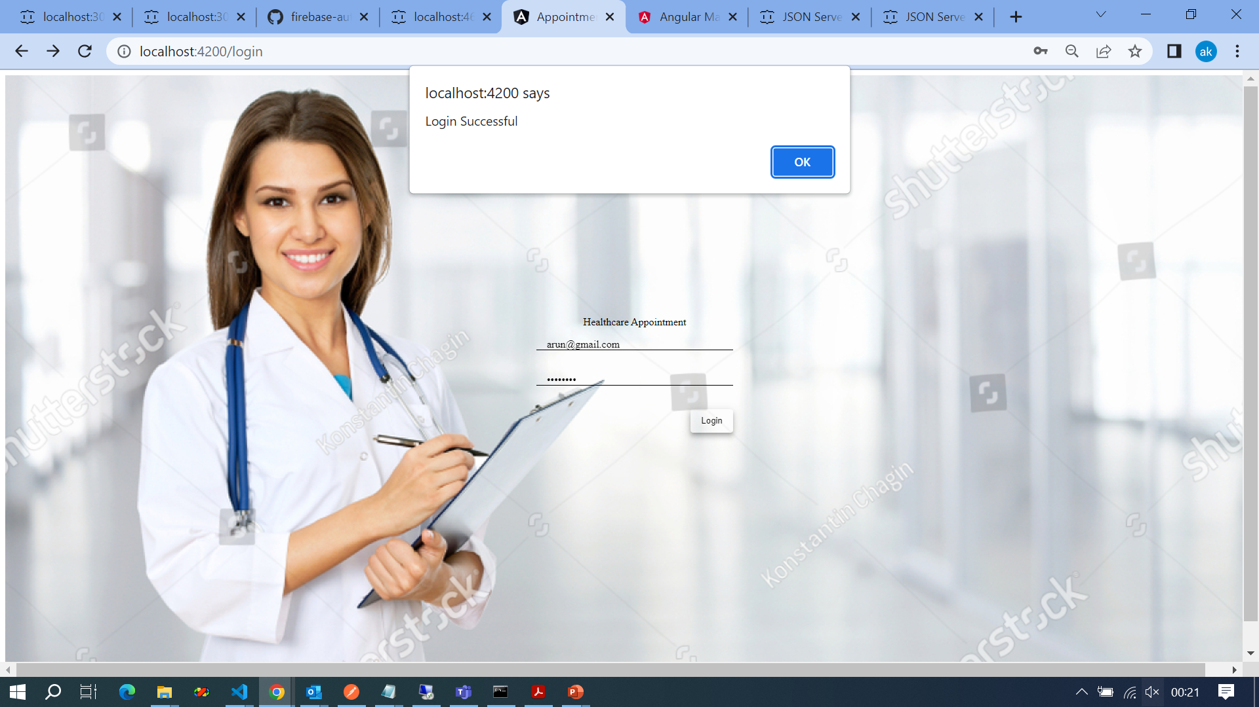

Slide 5
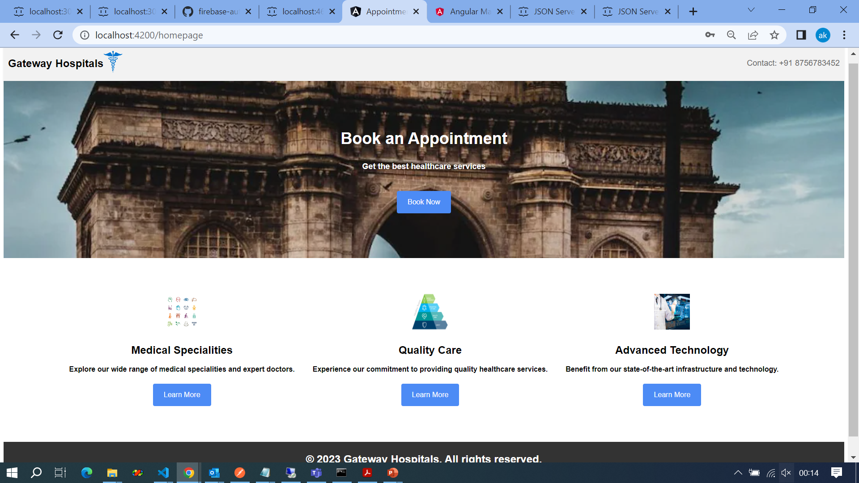

Slide 6
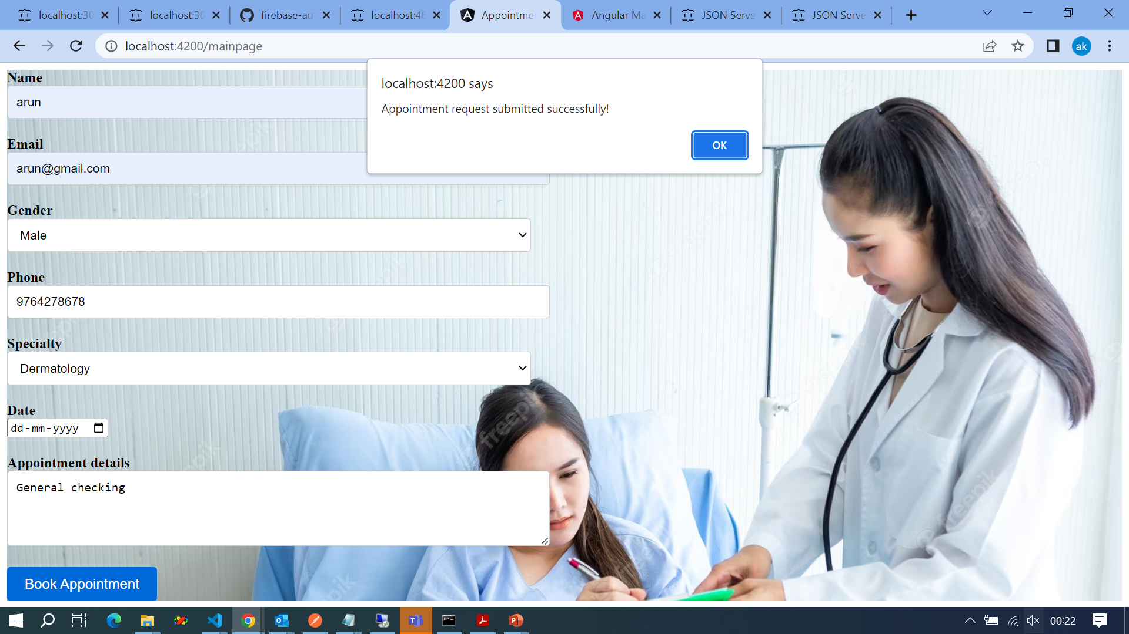

Slide 7
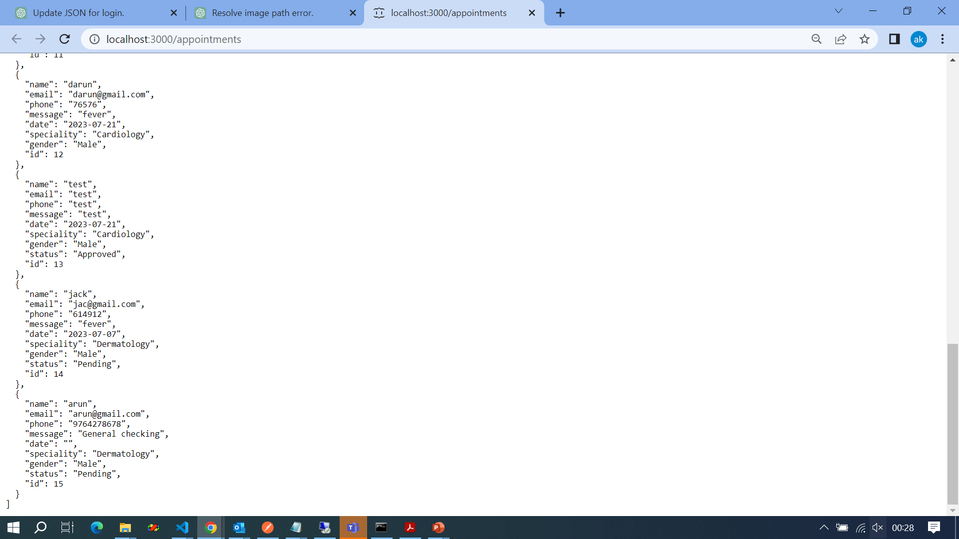

Slide 8
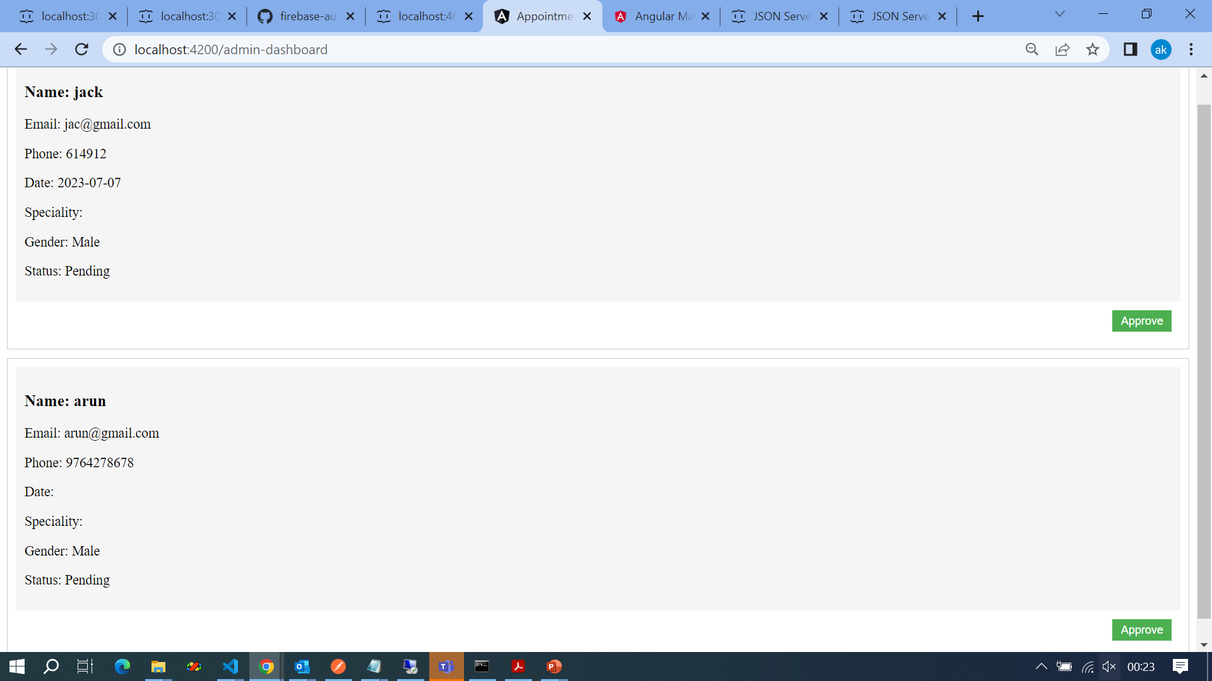

Slide 9
END
Thank YOU

